Slide 1

Resq robot
Muhammad farid izwan bin mohamad shabri
Muhammad amjad bin abdul malik
Muhammad amirul hakimi bin zaprunnizam
Muhammad iqbal bin mohd. Fauzi
Amit chakma
Abdul azeez olanlukun

Slide 2
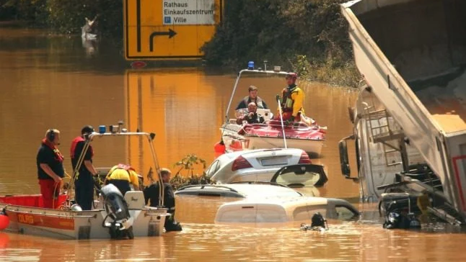
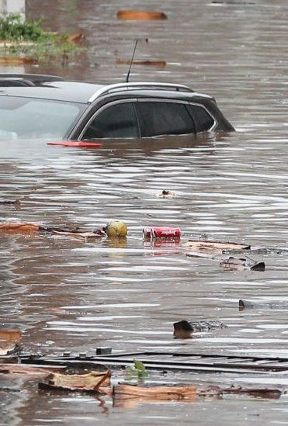

MOTIVATION OF PROJECT
www.bbc.com/news

Slide 3

Main parts
System Engineering
Design and Modeling
Coding

Slide 4
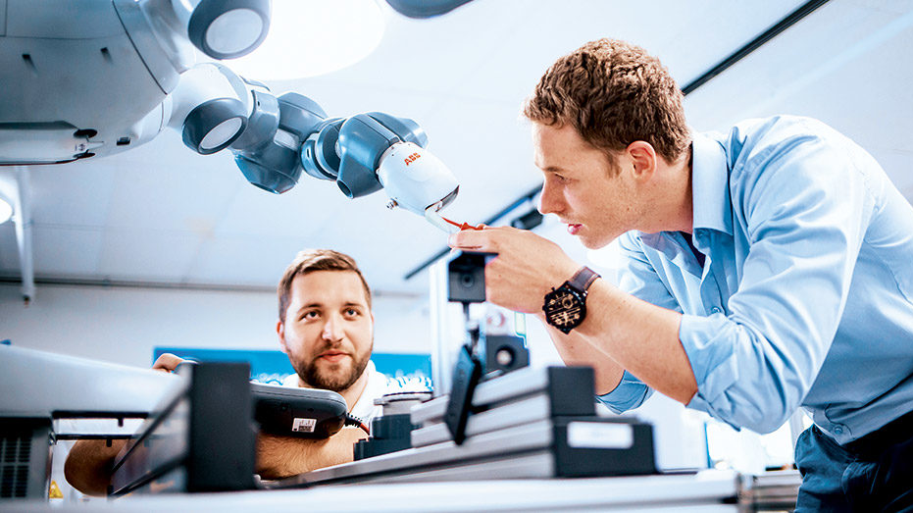
Design
- EARLY SKETCH
- 3D IMPLEMENTATION
- PRINTING

Slide 5
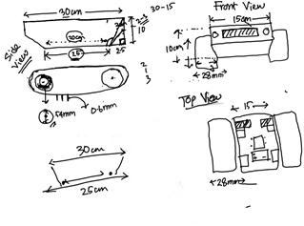
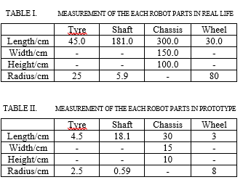
EARLY sKETCH

Slide 6
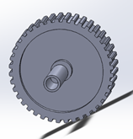
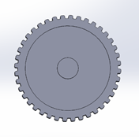
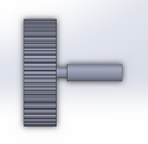
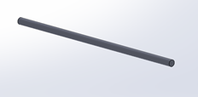
TYRES AND SHAFT
FRONT TYRES ARE CONNECTED TO EACH OTHER BY SHAFT
BACK TYRES ARE CONNECTED DIRECTLY TO THE MOTOR

Slide 7


WATER WHEEL
THE ROBOT WILL MOVE IN WATER USING THIS WHEELS
BOTH WHEELS ARE ATTACHED ON EACH SIDE OF ROBOT

Slide 8

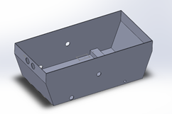
cHASSIS
IT INCLUDES SPACES TO PUT OTHER NECESSARY COMPONENTS
3 HOLES TO INSERT THE WHEELS, TYRES AND ULTRASONIC SENSORS ON THE FRONT OF ROBOT

Slide 9
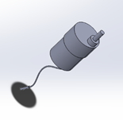
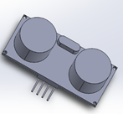
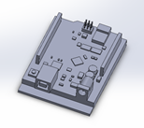
ELECTRONICS COMPONENTS
MOTOR
ARDUINO UNO
ULTRASONIC SENSOR
POWER SUPPLY

Slide 10
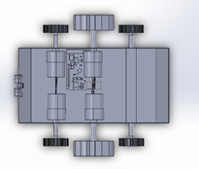
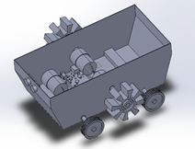
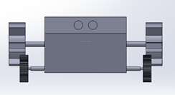
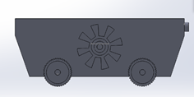
FINAL PROTOTYPE
3D AND 2D VIEW FROM FRONT AND SIDE

Slide 11
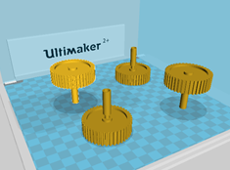

PRINTING
- WE HAVE USED A SOFTWARE CALLED ULTIMAKER CURA TO CALCULATE THE TOTAL ESTIMATION TIME TO 3D PRINT OUR ROBOT
- TOTAL TIME TAKEN TO PRINT EACH SINGLE PART OF ROBOT IS 33 HOURS AND 26 MINUTES

Slide 12

Coding
- PSEUDOCODE -IMPLEMENTATION

Slide 13

location - find the robot - find target

Slide 14
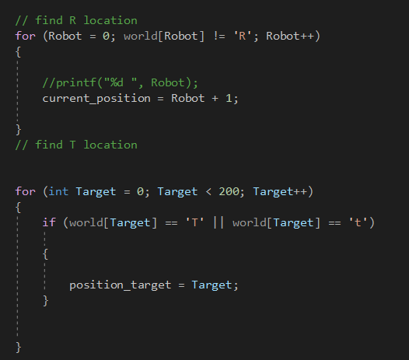
Find location of robot and target
Find robot position
Find target position

Slide 15
Array for queue - check neighbor

Slide 16
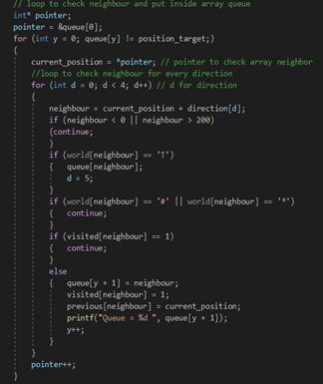
Check Neighbor of Robot
Check west ,east north , south
Check whether target is found
Check whether there is obstacles or wall
Mark visited neighbor
Change the value of "previous array"
Put the value of node in queue

Slide 17

Make Path - Reverse path - Correct path

Slide 18
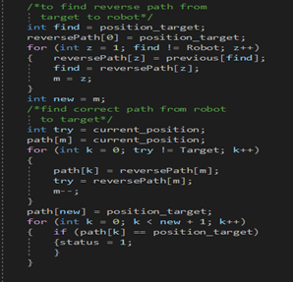
Find Reverse path and correct path
Reverse Path
Correct Path

Slide 19
Movement of robot - searching the target - return to its original position

Slide 20
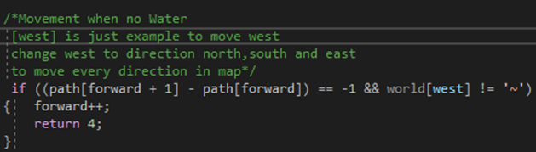
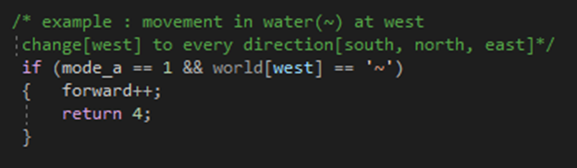
Robot move to target
Robot move on land
Robot move on water

Slide 21
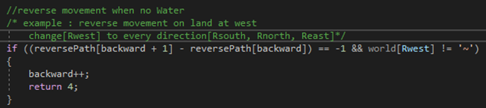
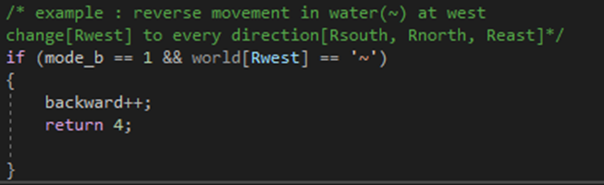
Move to its original position
Robot move on land
Robot move on water

Slide 22
Mode changing - toggling mode - land mode

Slide 23
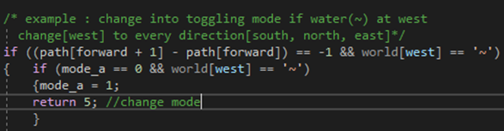
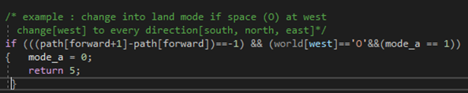
Path to find target
From land mode to toggling mode
From toggling mode to land mode

Slide 24
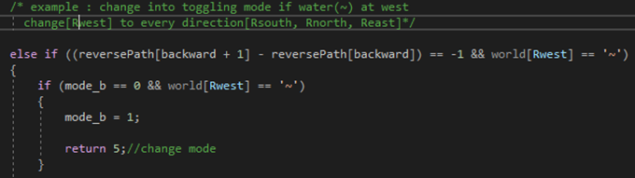
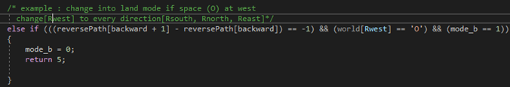
Path returning to its original position
From land mode to toggling mode
From toggling mode to land mode

Slide 25
Destroying obstacles (*)

Slide 26
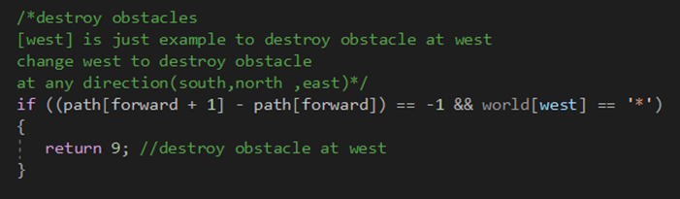

Slide 27
STAY IN WATER MODE - fOR TARGET ON WATER

Slide 28
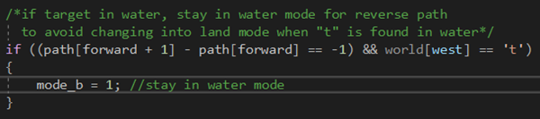
To differentiate target on land(T) & target on water(t)

